Slide 1
2023 Election Refresher
October 12, 2023
2023 Municipal Election Refresher
Presented by:
Kristin Warner, Esq.

Slide 2
General Elections
Governed by the New York State Election Law
Political Primaries occur on the fourth Tuesday in June before every general election
The Presidential Primary for 2024 is set to occur April 2nd
General Election occurs on the first Tuesday to succeed a Monday in November (this year 11/7)

Slide 3
School District and School District Library Elections
Governed by the New York State Education Law
Occurs on the third Tuesday of May each year

Slide 4
Village Elections
Governed by the New York State Election Law
Occurs on the third Tuesday in March

Slide 5
Special Rules for Village Elections
Village clerk must publish notice at least four months prior to the general village election designating the office or offices to be filled and the terms thereof.
At least 60 days before the election, the Board of Trustees must adopt a resolution that states:
  The polling place in each election district;
  The hours during which the polls shall be open (it must be at least from 12:00 pm – 9:00 pm)

Slide 6
Special Rules for Village Elections cont’d
At least 10 days before the election, the Village Clerk must publish a notice stating:
  The polling place in each election district
  The hours during which the polls will be open
  The names and addresses of all nominees and the office/term
  An abstract of any proposition to be voted on
In addition to the publication, a copy of the notice must be posted in at least six conspicuous public places within the village and at each polling place at least one day before the election

Slide 7
Special Rules for Village Elections cont’d
If a village uses voting machines, there must be one voting machine for each eight hundred qualified voters in each election district.
At least 40 days before the election, the board of trustees must appoint two or four inspectors for each village election district. This resolution will also fix the compensation and designate a chairman. Each inspector must file an oath with the village clerk prior to the assumption of their duties.
An application for an absentee ballot may be requested from the Village Clerk. It must be signed by the applicant and received no earlier than four months before the election and no later than seven days before the election if the ballot is to be mailed. The ballot must be received by the village clerk no later than the close of polls on election day.
Notes:
If in the previous election, both major political parties nominated a candidate for office, the inspectors must thereafter be appointed equally from enrolled members of such parties. This only has to occur as long as both parties are represented by candidates.

Slide 8
Special Rules for Village Elections cont’d
The Village Clerk acts as the Election Officer of the village and is responsible for the general conduct of the election.
Upon the close of the polls, the inspectors should begin canvassing the votes. Before 9:00 a.m., the next day, they must file with the village clerk the results of the election.
If there is a tie, a run-off election will be held on the first Tuesday at least ten days after the final certification of the tie result.
The tied candidates may waive their right to a run-off election and have the election decided by drawing lots.

Slide 9
Voter Qualifications
Be a United States Citizen;
Be 18 years old (may pre-register at 16 or 17, but cannot vote until age 18)
Resident of New York State and the county, city or village for at least 30 days before the election;
Not be in prison for a felony conviction;
Not be adjudged mentally incompetent by a court;
Not claim the right to vote elsewhere.
Notes:
This is actually surprising to many people. In May 2021, the state restored voting rights for all New York residents who are not in prison. Prior to this change, New York did not allow people on parole to vote. As soon as they are released from prison, they are entitled to re-register. New Yorkers who are on parole, probation, or other supervised release are entitled to register to vote. New Yorkers who are in jail for a misdemeanor or a violation conviction are similarly eligible to register to vote.
There are actually only 9 states in the country where a person with a felony conviction may permanently lose their right to vote IN THAT STATE ONLY. If a person with a felony conviction from another state moves permanently to New York, they are entitled to register to vote here.
There are 23 states, NY included, where ability to vote is restored after prison; 15 states where right to vote is restored after prison, parole & probation; 1 state where vote is restored after prison & parole; and in Maine, Vermont, and Washington DC, voting is unrestricted, i.e., a person in prison for a felony conviction may vote from prison.

Slide 10
Registration
To vote in an election in New York State, a person must be registered to vote. By registering with the local County Board of Elections, a person is thereafter entitled to vote in any election covering the location (e.g., village, town, city, county) where the person resides.
A voter registration form must be received by the board of elections by the 10th day before the election in order to vote in that election.
Notes:
People can register to vote online using the New York State Board of Elections’ Online Voter Registration portal; in person at the county board of elections and either in person or on the DMV website if the person already has DMV-issued identification. Registration forms may be requested online or by calling the 1-800-FOR-VOTE hotline.

Slide 11
Changes to Voter Registrations
Changes of Name and/or Address can be done via change of address form and must be received at least 15 days before a special, primary or general election by the county board of elections.

Slide 12
Victims of Domestic Violence
New York State allows victims of domestic violence to apply for a confidential registration.
This is done by delivering a sworn statement to their local county Board of Elections stating that they are a victim of domestic violence and they wish to have their voter registration record kept confidential because of the threat of physical or emotional harm to themselves or a family or household member.
Once received, their voter registration record will be kept separate and apart from other registration records for four years.
Notes:
Their voter registration record will not be made available for inspection or copying by the public or any other person, except election officials acting within the scope of their official duties. Under a separate section of the law, they can also be excused from going to their polling place to vote and get a special ballot.

Slide 13
Residency
Residency issues do not usually arise when a person registers to vote, but more often pop up during the absentee/affidavit ballot canvassing process, candidate petitioning process, or when a candidate’s residency or duration of residency is challenged.
When determining residency, a variety of factors may be considered.
If a person has two residences, they may choose which to use for voting purposes.
Notes:
A voter’s residence and duration of residence determines where a person can register to vote and whether a person can be a candidate for public office.
These factors include: person’s residence for income tax purposes, age, marital status, residence of parents/spouse and children; real property owned by the applicant; motor vehicle records; utility bills, etc.
“The crucial factor in determining if an individual is qualified to register and vote from a particular residence is whether he or she has manifested an intent to adopt that residence as a permanent and principal home coupled by his or her physical presence there without any aura of sham” 2nd Department case – Matter of Thompson v Karben, 295 AD2d 438, 439
In New York, a person with two residences “may choose to which he has legitimate, significant and continuing attachments as her residence for purposes of the Election Law” rather than having to prove that one of them is their “domicile.” (Wit v Berman, 306 F3d 1256 [2nd Cir. 2002]). They may only choose and vote using one residence.

Slide 14
Residency of Candidates
Technically, there is no state law requirement that a candidate for a local office reside in the district in which the election is sought at the time the petition is filed.
Public Officers Law §3(1) states that candidates must satisfy residency requirements “as of the time they are elected.”
That being said, local charters or laws may impose more stringent residency requirements for local offices.
Different offices have different requirements.
Factors for determining voter residency also apply to candidate residency.
A challenge will fail unless “clear and convincing evidence” demonstrates that the candidate did not meet the residency requirement.
Notes:
The law (Election Law 6-122) simply prohibits a person from being designated or nominated for public office if they cannot meet the qualifications “at the commencement of the term of such office.”
For example, candidates for the New York State Senate or Assembly must meet two constitutional residency requirements: (1) Five years of residency in the state; and (2) residency in the district for ‘twelve months immediately preceding his or her election” and the residency period must be continuous, not intermittent. For an election immediately following redistricting, a candidate for state legislature is not required to have lived in the district, but must have resided within the county in which the district is contained for twelve months immediately before the election.
While there is no single test for determining residency, the Court of Appeals has previously held that a candidate fails the Constitutional residency requirement when he or she registers to vote in another jurisdiction during the required residency period.

Slide 15
Political Primaries
Generally, New York is a “Closed Primary” State.
To change a voter’s party enrollment for the primary election in any given year, the voter registration form must be received no later than February 14th of that year.
A political party may cancel a voter’s enrollment with a party when they find the voter is “not in sympathy with the principles of such party.” Once a voter is disenrolled pursuant to the statutory proceedings, s/he may no longer participate in the party’s primary elections or caucuses.
Notes:
This means that only those enrolled in a political party may vote in the party’s primary election or participate in the party’s caucus. However, a political party may opt to allow non-party members to vote in their primary election as specified by party rule, though this is a very rare occurrence (State Committee of the Independence Party v Berman, 294 F Supp 2d 518 [SDNY 2003]).

Slide 16
Designating Petitions
Petitions must be in substantially the form set forth by the Election Law.
If a party nominates its candidates through the primary election process, party designations for the primary are made on a designating petition. The number of signatures required on a petition vary by office. Only enrolled members of the party qualified to vote for an office are eligible to sign a designating petition.
If a designating petition contains a greater number of candidates than there are offices to be elected, the entire petition is invalid. An over-designated petition cannot be cured by having the extra candidates decline.
Notes:
People wishing to run for elective office may either be designated by a political party or nominated through the filing of an independent nominating petition.
Basically, the test is just if the form contains the required information.
Over-designation (Elgin v Smith, 10AD3d 483 [4th Dept 2004])

Slide 17
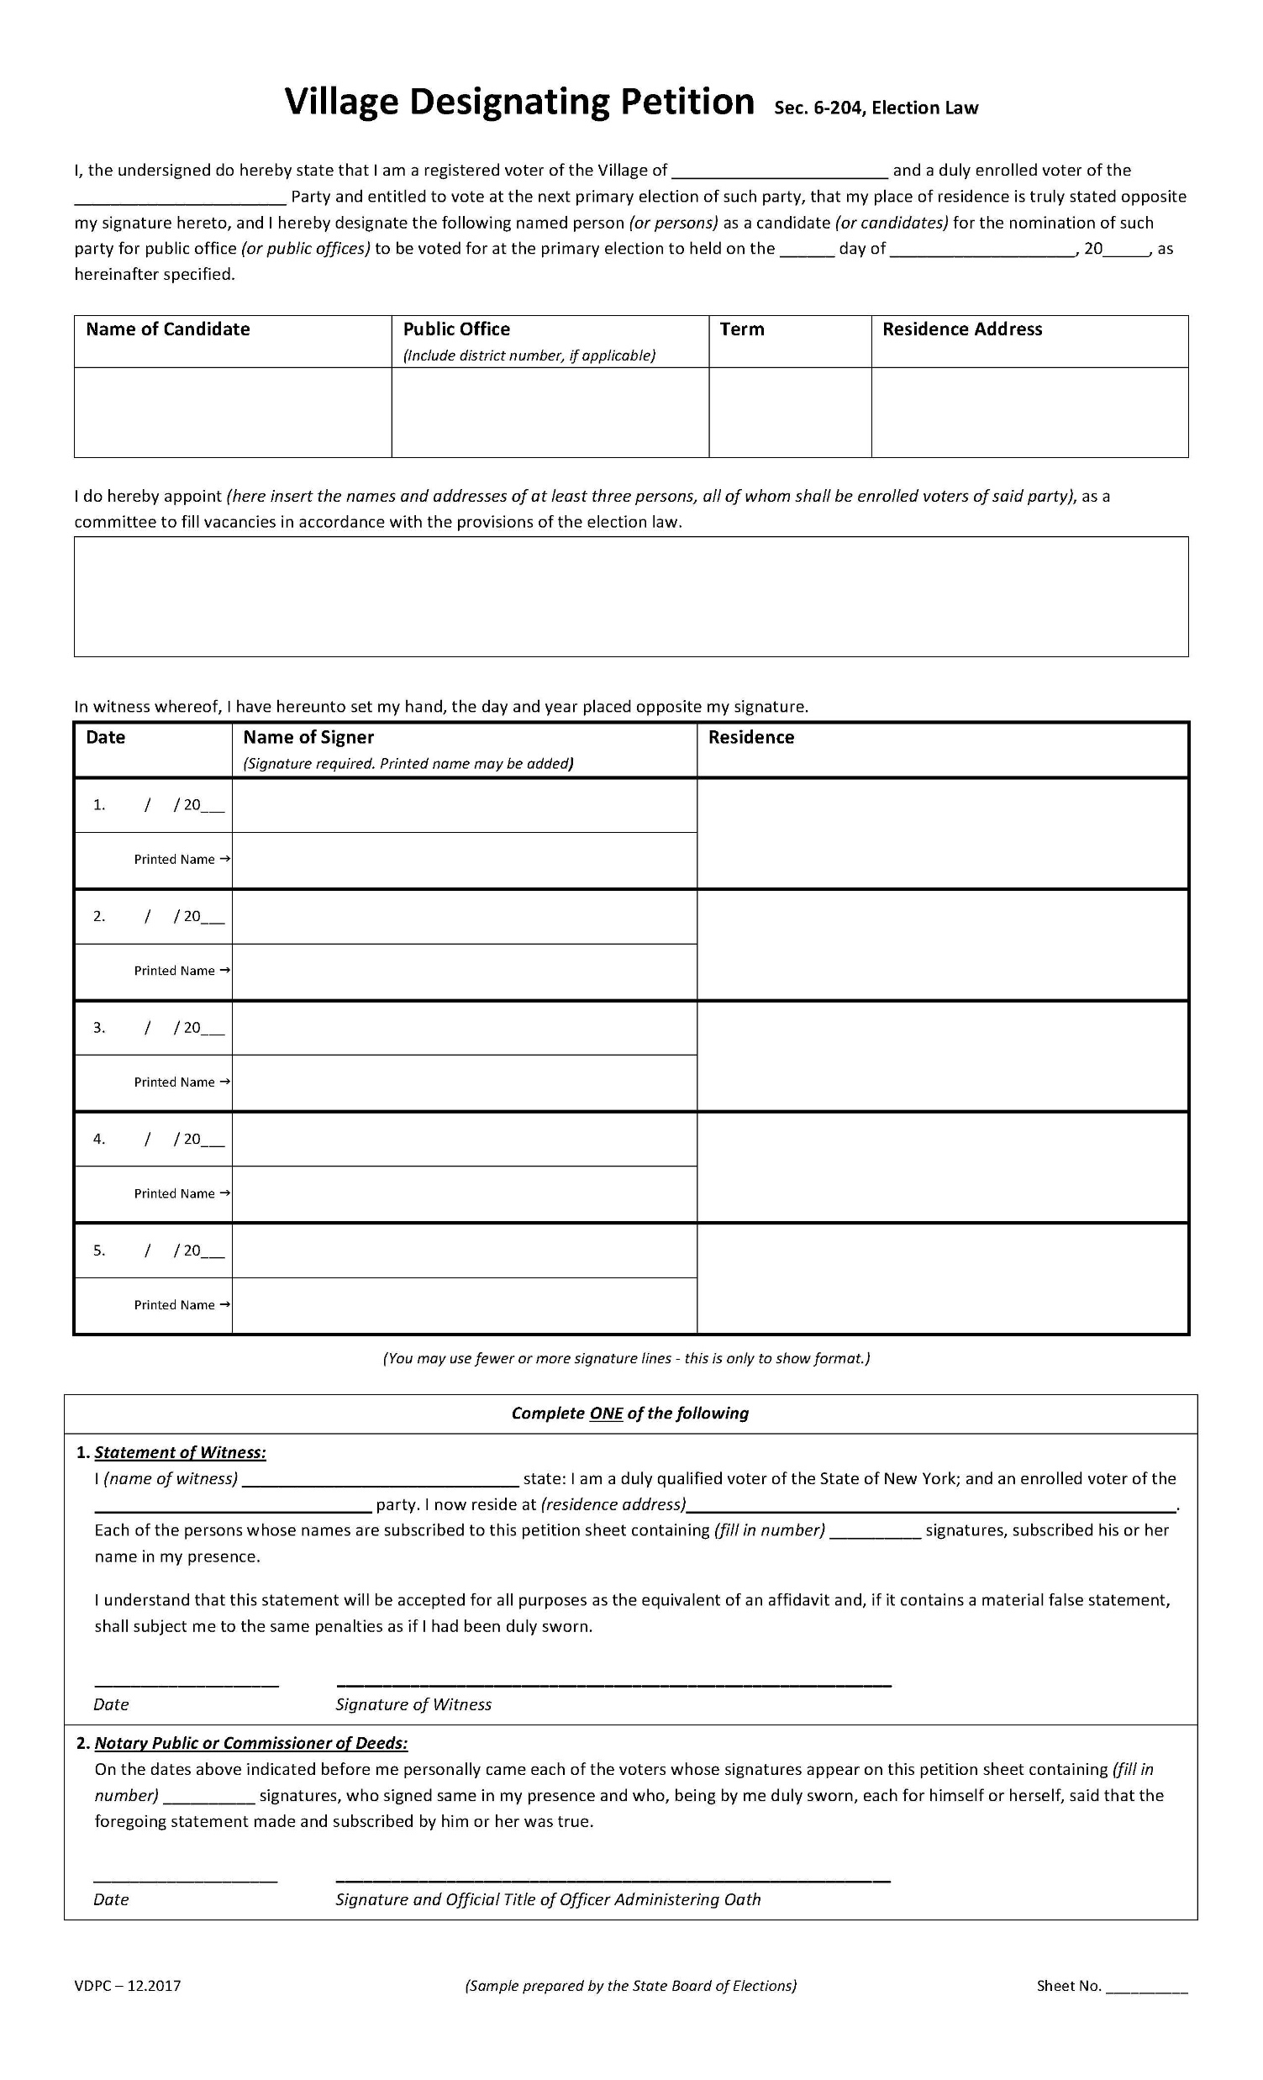
Sample Village Designating Petition

Slide 18
Number of Signatures Required – Designating Petition
Nominating petitions must be signed by “not less than five percent” of the enrolled voters of the party residing within the election jurisdiction (i.e., a Republican running for Village office must have signatures equal to or greater than 5% of registered Republicans in that given village) except for the following public offices, the number of signatures need not exceed:
  For cities or counties with >250,000 inhabitants, 2,000 signatures;
  For cities or counties with >25,000 and <250,000, 1,000 signatures;
  For any other city or county, 500 signatures;
  For any congressional district, 1,250 signatures;
  For any state senatorial district, 1,000 signatures;
  For any state assembly district, 500 signatures;
  For any county legislative district, 500 signatures.
  For any village, 5% of the number of enrolled voters of the party residing in the village
Notes:
These do not include the requirements for petitions in New York City – they have their own set of numbers.
For any political subdivision contained within a larger subdivision, the smaller one cannot have a higher number of signatures required.
In villages, party nominations for candidates are made at a party caucus and a list of enrolled members of the party who participated in the caucus is provided to the Village Clerk with the Designating Petition.

Slide 19
Independent Nominating Petition
To run for office on a line other than an official party line, a candidate must file an independent nominating petition.
The number of signatures required to qualify the candidacy of a person on an independent party line also varies by office.
Any registered voter who has not already signed a designating petition, and who is qualified to vote for an office, may sign an independent nominating petition for that office.

Slide 20
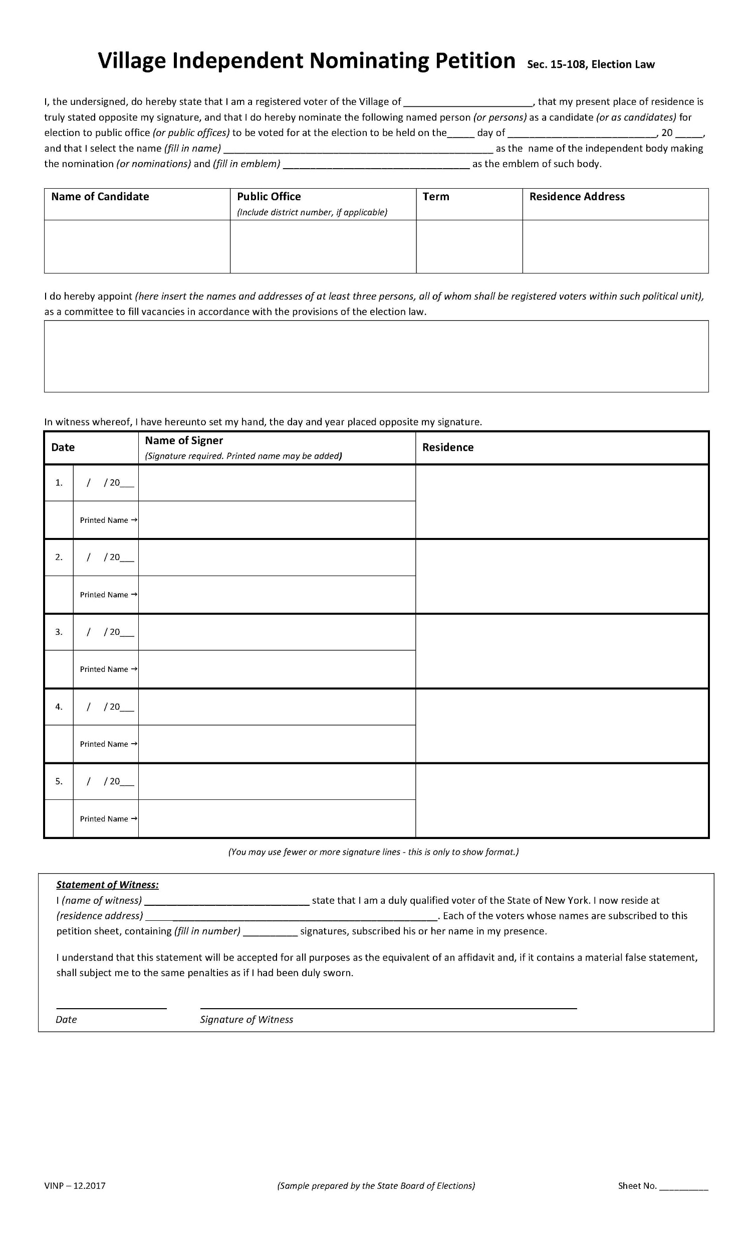
Sample Village Independent Nominating Petition

Slide 21
Number of Signatures Required – Independent Nominating Petition
Nominating petitions must be signed by “voters numbering five per centum of the total number of votes cast for governor at the last gubernatorial election in such [political] unit” except that not more than 3,500 signatures shall be required for any office outside of the City of New York and not more than the following number of signatures shall be required for the following public offices:
  For any county office outside NYC, 1,500 signatures;
  For any congressional district, 3,500 signatures;
  For any state senatorial district, 3,000 signatures;
  For any state assembly district, 1,500 signatures.
  For a village with a population >5,000, 100 signatures
  For a village with a population <5,000, 75 voters
  For a village with a population <3,000, 50 voters
  For a village with a population <1,000, 5% of voters at last village election
Notes:
These do not include the requirements for petitions in New York City – they have their own set of numbers.
For any political subdivision contained within a larger subdivision, the smaller one cannot have a higher number of signatures required.

Slide 22
Petitions
Invalidation of a single signature, or a number of signatures, in the absence of fraud, does not render the entire page invalid.
There is no requirement that signatures on a designating or independent nominating petition be in sequential date order.
If a petitions is required to have a coversheet under Election Law Section 6-134 and none was filed, that is a fatal defect and is uncurable.
The pages of a petition must be numbered.
The date of the election on any petition must be stated accurately and correctly.
Notes:
While the failure to number the pages is a defect that will invalidate the petition, this defect is curable.

Slide 23
Candidate Qualifications
Boards must assume that the candidate meets constitutional and statutory qualification requirements.
A candidate may not run for two public offices where one would be precluded from holding both at the same time.
There is no requirement that a person must be registered to vote to be a candidate for public office.

Slide 24
Candidate’s Information
The candidate must be able to be identified by the information provided.
The law requires that the candidate’s name, the specific office being sought, including district number if any, place of residence and post office address if different be included.
The name that a candidate uses on his/her petition is that which will appear on the ballot. A recognizable nickname, such as “Tom” for Thomas or “Jack” for John may be used on the petition so long as there is no intent to mislead signers.
A name cannot use titles of descriptors, e.g., “Dr.,” “Esq.”, “PhD”
A misspelling is not a fata defect if there was no intent to mislead.
Notes:
Please note that you cannot invoke the personal privacy exception on behalf of a requester. When it is just the requester whose privacy would be invaded, they may provide a copy of their government-issued ID and sign a waiver. You would send it with a letter that states: “Because the records you have requested pertain to yourself, but if released to the public would constitute an unwarranted invasion of your privacy, as a condition precedent to disclosure, please prepare the following statement on a separate sheet of paper, sign it, and mail it to the address indicated below, along with a copy of your valid driver license or other acceptable form of identification.
“I certify that my name is _________
That I reside at _______________
That I have attached a copy of my valid driver license or equivalent identification and that the requested records pertain to myself.”
RPTL 104 deals with electronic property tax administration.

Slide 25
Petition Signers
The Election Law requires the date, name of signer, residence, and town or city for each signer. All required information must be provided in ink.
The signature must have the date it was made and strict compliance is required. Signatures dated after the witness statement cannot be counted.
A signature does not have to be in cursive, but a printed signature may be invalidated if the signature example on file with the board of election is not also printed.
A power of attorney cannot sign a petition for a voter.
A signer must provide “town” or “city” – a village or hamlet is not acceptable.
Signatures of persons who signed a previous petition for the same office are not valid.
Notes:
Kind of an outdated concept, but a wife is not allowed to sign her name as “Mrs. John Jones” if her name is Mary. She can sign as “Mrs. Mary Jones.”

Slide 26
Alterations
Uninitialed alterations or corrections may be made to information on the signer’s line of a petition, except to the signature and date.
Any alterations to the signature or date must be initialed.
Notes:
Just marking something “draft” does not make it exempt. It needs to be an actual non-final draft of a record.
“Draft” minutes are still FOILable – minutes do not have to ever be approved under OML.
There is no exception for “personnel records” – sometimes the content can be redacted, but for the most part those are subject to disclosure.
Putting a confidentiality clause in a settlement agreement does not trump access rights under FOIL.

Slide 27
Fraud
Fraud is usually an issue left for judicial proceedings.
Fraudulent signatures will be invalidated.
If it is found that fraud permeates a petition or the candidate is the one who committed the fraud, the entire petition will be invalidated, even if the number of signatures remaining are sufficient.
The challenger must show permeation of fraud by “clear and convincing evidence.”
Notes:
Clear and convincing evidence is a high burden. It means that it must be show that it is highly and substantially more likely that fraud occurred. This is a stricter standard than traditional civil liability standard: preponderance of the evidence which requires you to show that it is simply more likely than not that something occurred Basically, just a more than 50% chance. . It is not as strict as that which is used to determine criminal culpability – the beyond a reasonable doubt standard.

Slide 28
Campaign Finance Disclosures
Election Law requires candidates and political committees to file statements disclosing information about contributions received and expenditures made in connection with an election.
Candidates must file two disclosure statements prior to the election (first – <30 days, but no more than 45 days before election; second - <11 days, but no more than 15 days before election) and one within 27 days following the election.
Notes:
Constructive denials may be appealed. If they are still not provided an answer, a requester may file an Article 78 proceeding against the agency. When a court finds that the requester has “substantially prevailed” and the agency failed to respond to a request or appeal within the statutory time, the court may assess attorney’s fees.

Slide 29
Absentee Ballots
A voter is eligible for an absentee ballot if they will be:
  Absent from the county on Election Day;
  Unable to appear at the polls due to temporary or permanent illness or disability;
  Unable to appear because they are the primary care giver of one or more individuals who are ill or physically disabled;
  A resident or patient of a Veterans Health Administration Hospital;
  In jail or prison for any reason other than a felony conviction. This includes anyone who is awaiting grand jury action, awaiting trial, or serving a sentence for a misdemeanor.
Notes:
Temporary illness or disability no longer includes the fear of contracting COVID or other communicable diseases. That provision sundowned at the end of 2023.

Slide 30
Absentee Ballots cont’d
A person may apply for an absentee ballot via the following means:
  Using the online Absentee Ballot Application portal;
  Going in-person to their local county board of elections;
  Designating another person to deliver their application in-person to their local county board of elections and receive their ballot

Slide 31
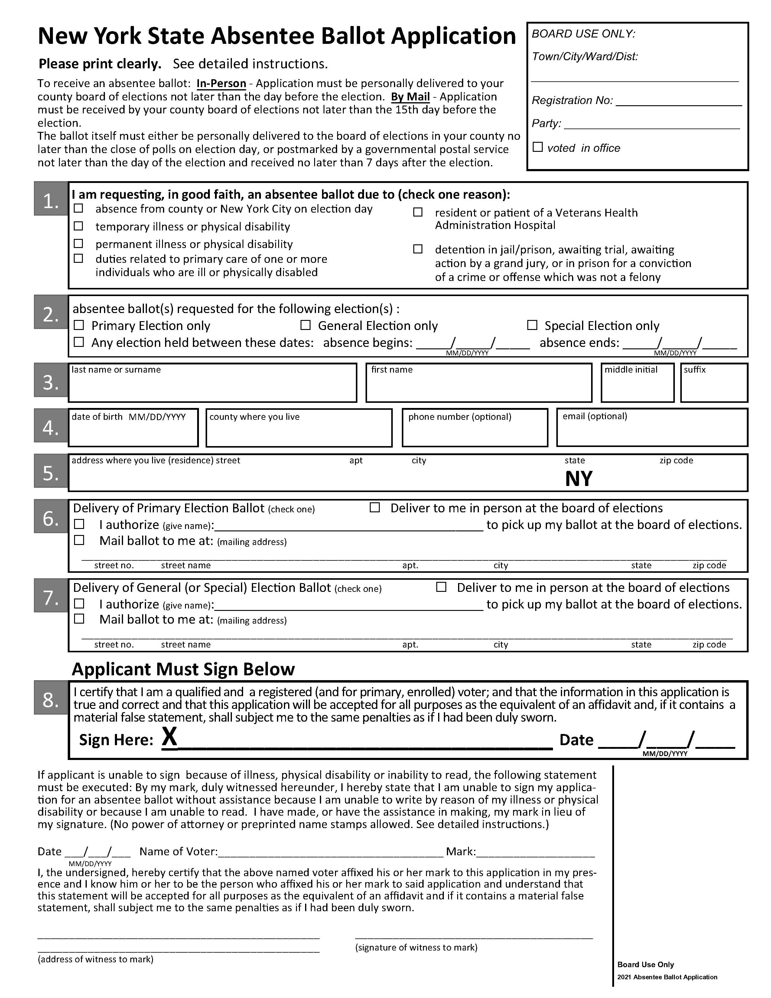
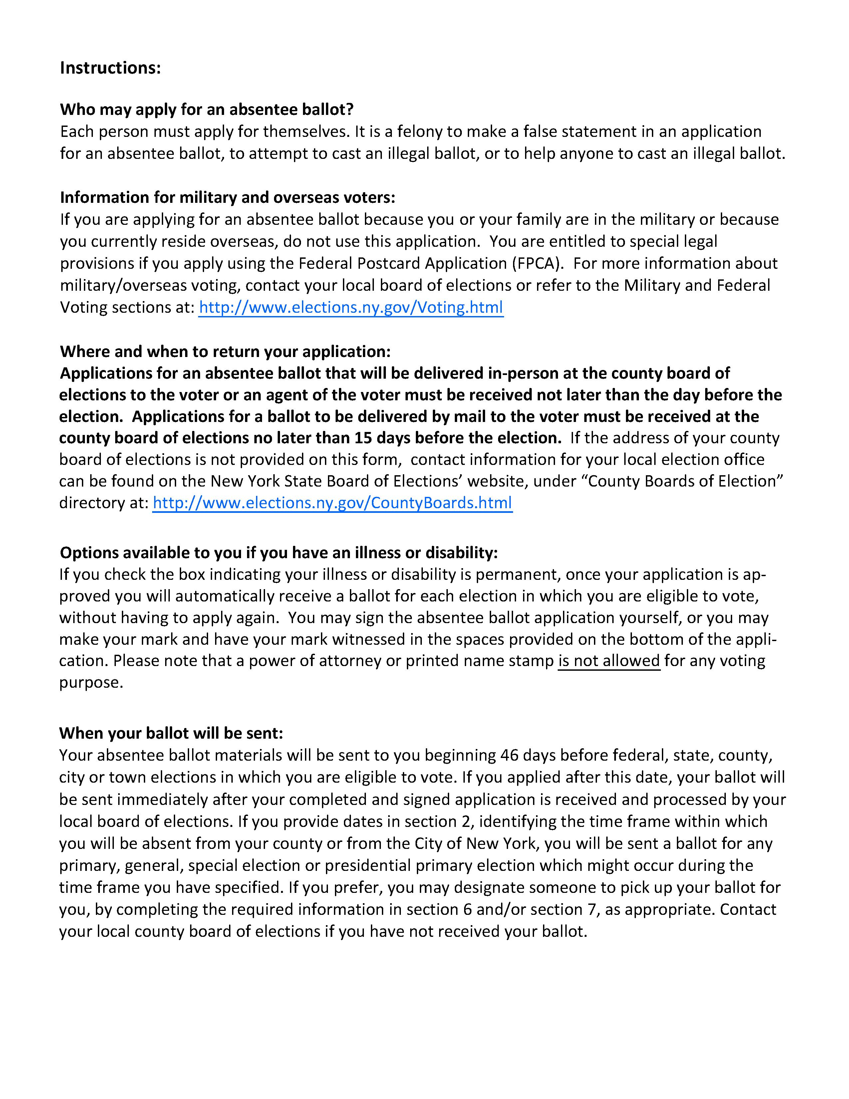
Sample Absentee Ballot Application

Slide 32
Absentee Ballot Deadlines
Applications requesting an absentee ballot by mail or through the electronic absentee ballot application transmittal system must be received by the Board of Elections no later than the 15th day before the election.
Applications requesting an absentee ballot that will be delivered in person must be received by the board of election no later than the day before the election.
Notes:
These deadlines are set to change January 1, 2024. The new deadline will be no later than the tenth day before the election.

Slide 33
Absentee Ballots for Permanent Disability
A voter who claims permanent illness or disability may make an application for an absentee ballot and the right to receive an absentee ballot for each election thereafter, by filing with the board of elections an application which includes such a statement signed by the voter.
The board of elections will then mark their registration card “Permanently Disabled” and an absentee ballot will be sent to the voter for every subsequent primary, special, or general election at his or her last known address until the voter’s registration is cancelled.

Slide 34
Military Voters
Those persons serving in the military, along with their spouses and/or dependents, may register as a military voter in New York.
This entitles them to receive an absentee ballot for all federal, state and local races that they would otherwise be entitled to vote in if they were to go to their assigned polling place based on their New York residence.
To register, a voter must complete a Federal Post Card Application and return it to their county board of elections.

Slide 35
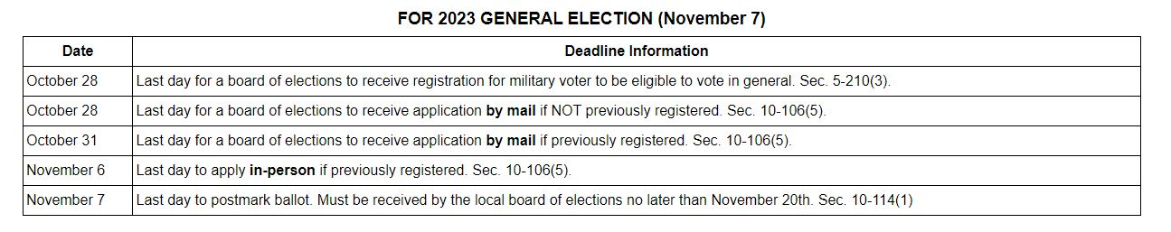
2023 Military Ballot Deadlines

Slide 36
Early Voting
Beginning the tenth day prior to any election and ending on the second day prior to any election, persons registered and eligible to vote may do so at the locations designated by the board of election as early voting sites.
This may or may not be the same location designated as the voter’s election day polling place.
In counties with less than 500,000 registered voters, there has to be one early voting polling place for every 30,000 registered voters (but there does not need to be >10 or <1 polling place)
In counties with more than 500,000 registered voters, there must be an early voting polling place for every 40,000 registered voters

Slide 37
Early Voting cont’d
The board of elections must secure all ballots and scanners used for early voting from the beginning of the early voting period through the close of the polls on election day.
Ballots cast during early voting may not be canvassed until one hour prior to the close of the polls on election day.

Slide 38
Election Inspectors
For each election district, there must be four election inspectors.
At every general election in each election district where two voting machines are used, there must be an additional two poll clerks.
These appointments must be equally divided between the major political parties.
They must be registered voters and residents of the county in which they serve.
Election inspectors and poll clerks must be compensated at a rate set by the county legislature, but there is no minimum set outside of New York City.

Slide 39
Watchers
Any party committee, any independent body whose candidates are on the ballot, and any political committee supporting or opposing a ballot proposal may have three watchers for each district election.
Watchers must be appointed by the chair or other officer of each such body.
They may be present at the polling place at least 15 minutes before the unlocking and examination of any voting machine or ballot box at the opening of the polls, until after the signing of the inspectors’ returns and proclamation of the result.

Slide 40
Watchers cont’d
Watchers should be appointed by a certificate in writing issued by the appointing authority. Each certificate should be delivered to an inspector at the election district.
A watcher must be a qualified voter of the city or county in which s/he is to serve.
A watcher cannot be a candidate for public office in the same election.
A candidate may visit a polling place while the polls are open.

Slide 41
Affidavit Ballots
If a voter’s name appears with a notation indicating that the board of elections has issued the voter an absentee, military or special ballot, the voter may not vote on a voting machine at an early voting site or on election day but may vote by affidavit ballot.
If a voter presents themselves to cast a ballot and claims to live in the election district, but no registration record can be found, they may still vote via affidavit ballot.
If a person shows up at an incorrect polling place, but in the correct county and correct assembly district, that person is entitled to vote by affidavit ballot.

Slide 42
Electioneering
While the polls are open, no one may electioneer within the polling place or in any public street, within a 100-foot radius, measured from the entrance to the polling place.
No political banners, buttons, posters, or placards are allowed in or on the polling place or within that 100-foot radial.

Slide 43
Voter Challenges
Any voter may be challenged as to his/her right to vote or his right to vote by absentee or military ballot.
Such challenge may be made by an inspector or clerk, a watcher, or by any registered voter properly in the polling place.
When an applicant is challenged, an inspector must administer a preliminary oath: “You do solemnly swear (or affirm) that you will make true answers to such questions as may be put to you concerning your qualifications as a voter” – if the voter refuses, he shall not be permitted to vote.

Slide 44
Voter Challenges cont’d
Once the preliminary oath is administered, the inspector may question the voter about his right to vote at that polling place. If he refuses to answer any question, he will not be permitted to vote.
If the inspector believes, after questioning, that the voter is qualified or the challenge is withdrawn, the voter shall be permitted to vote.
If the voter appears deficient in any way, the “qualification oath” should be administered.
There are separate oaths for those accused of bribery and being adjusted incompetent.
If he refuses any oath, he cannot vote. If he swears the oath, he may be permitted to vote.
Notes:
“You do swear (or affirm) that you are eighteen years of age, that you are a citizen of the United States and that you have been a resident of this state, and of this county (of the city of New York) (village) for thirty days next preceding this election, that you still reside at the same address from which you have been duly registered in this election district, that you have not voted at this election, and that you do not know of any reason why you are not qualified to vote at this election. You do further declare that you are aware that it is a crime to make any false statement. That all the statements you have made to the board have been true and that you understand that a false statement is perjury and you will be guilty of a misdemeanor.”

Slide 45
Election Day
Polls must be open from six o’clock in the morning until nine o’clock in the evening.
Election Day ballots, absentee ballots, and military ballots may not be canvassed prior to the close of the polls.
At the close of the polls, the inspectors must close the polls, account for any paper ballots, canvass the voting machines, cast and canvass all the ballots, and canvass and ascertain the total vote. They cannot adjourn until everything is completed.

Slide 46
Election Day cont’d
Once all votes have been canvassed, the chair of the board of inspectors will make a public oral proclamation of the total number of votes cast at the election at the polling place for all candidates of each office. The chair may, in the alternative, post the result tape, tally sheet, or other material necessary to ascertain the total number of votes cast.

Slide 47
Questions
If you have any questions that arise after this session, feel free to direct them to Kristin Warner at kwarner@bsk.com
Thank you!

